Slide 1
Objectives
In this session, you will learn to:
  Declare, create, and initialize arrays
  Write code to copy array values from one array to another
  Define inheritance, polymorphism, overloading, overriding, and virtual method invocation
  Define heterogeneous collections
  Use objects casting
  Describe overloading methods and overloading constructors
  Define wrapper classes
  Define autoboxing of primitive types

Slide 2
Declaring Arrays
Arrays are used typically to group objects of the same type and they are referred to the group of objects by a common name.
Arrays can be declared of any type either primitive or class.
The declaration of an array creates space for a reference.
Actual memory allocation is done dynamically either by a new statement or by an array initializer.

Slide 3
Demo: Creating Arrays
Let us see the demonstration of declaring, creating and manipulating an one-dimension array of primitive type elements.

Slide 4
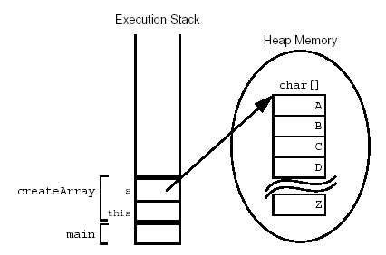
Demo: Creating Arrays (Contd.)
The following figure displays the creation of an array of character primitives.

Slide 5
Demo: Creating Reference Arrays
Let us see the demonstration of creating an array of objects.

Slide 6
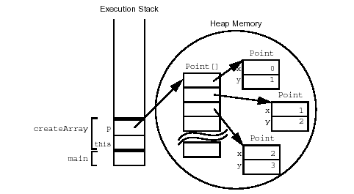
Demo: Creating Reference Arrays (Contd.)
The following figure displays the creation of an array of character primitives with objects.

Slide 7
Initializing Arrays
Every element is initialized at the time of array creation.
The following code snippet displays an array with initial values:
  String[] names = {
  "Georgianna",
  "Jen",
  "Simon"
  };

Slide 8
Multidimensional Arrays
Multidimensional arrays can be termed as an arrays of arrays.
The following code snippet displays a two-dimensional array:
  int[ ][ ] twoDim = new int [4][ ];
  twoDim[0] = new int[5];
  twoDim[1] = new int[5];

Slide 9
Array Bounds
In the Java programming language, all array indices begin at 0.
The number of elements in an array is stored as part of the array object in the length attribute.
If an out-of-bounds runtime access occurs, then a runtime exception is thrown.

Slide 10
Using the Enhanced for Loop
An enhanced for loop is used to make array iteration easier.
The following code snippet displays an enhanced for loop that iterates over the array:
  public void printElements(int[] list) {
  for ( int element : list ) {
  System.out.println(element);
  }
  }

Slide 11
Array Resizing
After an array is created, it cannot be resized.
The same reference variable is used to refer to an entirely new array.
The following code snippet displays a reference variable being used for a new array:
  int[] myArray = new int[6];
  myArray = new int[10];

Slide 12

Copying Arrays
The Java programming language provides an arraycopy() method in the System class, which is used to copy arrays.
It is a method that only copy references and not objects, when dealing with arrays of objects.
Let us understand the concept of arraycopy() method by using the embedded document.

Slide 13
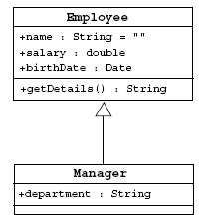
Subclassing
Subclassing is a way to create a new class from an existing class.
The following figure displays an implementation of the Manager class that inherits from the Employee class.

Slide 14
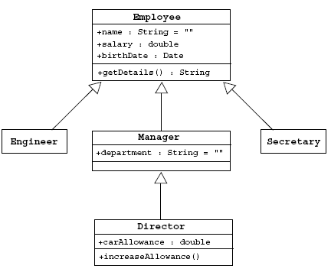
Single Inheritance
The Java programming language permits a class to extend a single class only. This restriction is called single inheritance.
The following figure displays an example of inheritance tree.

Slide 15
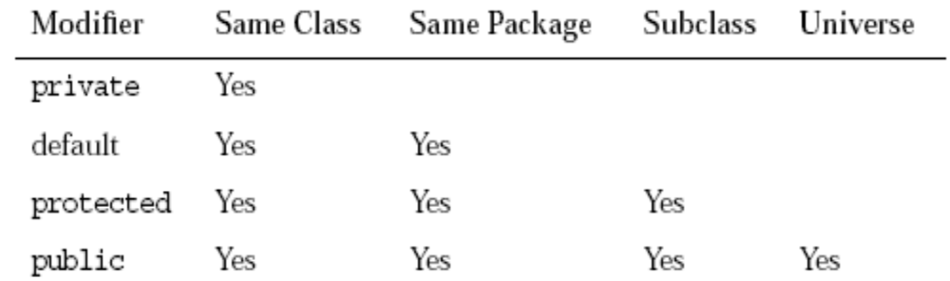
Access Control
Variables and methods can be at one of four access levels:
  public
  protected
  default
  private
The following figure displays the various access levels used in Java.

Slide 16
Overriding Methods
  In addition to producing a new class based on an old one by adding additional features, existing behavior of the parent class can be modified.
  To override the old method of the parent class, the new method of the derived class need to match the name, return type, and argument list of the parent method.

Slide 17
Overridden Methods Cannot be Less Accessible
The method name and the order of arguments of a child method must be identical to those of the method in the parent class for that method to override the parent’s version.
An overriding method cannot be less accessible than the method it overrides.

Slide 18

Invoking Overridden Methods
A subclass method can invoke a superclass method using the super keyword.
The super keyword refers to the superclass of the class in which the keyword is used and refers to the member variables or the methods of the superclass.
Let us understand the concept of super keyword by using the embedded document.

Slide 19
Polymorphism
Polymorphism is the ability to have many different forms (the one that is given to it when constructed).
A variable is polymorphic because it can refer to objects of different forms.
The Java programming language, like most object-oriented languages permits to refer to an object with a variable that is one of the parent class types.
The following code snippet displays the variable e, which can access only the parts of the object of Employee class:
  Employee e = new Manager(); //legal

Slide 20
Virtual Method Invocation
Virtual method invocation gets the behavior associated with the object to which the variable refers at runtime.
The behavior is not determined by the compile time type of the variable.

Slide 21
Heterogeneous Collections
Collections of objects with different class types are called heterogeneous collections.
The Java programming language has an Object class.
It is possible to make collections of all kinds of elements because all classes extend class Object.

Slide 22
Polymorphic Arguments
It is possible to write methods that accept a generic object and work properly on objects of any subclass of this object.
The following code snippet displays the polymorphic features:
  public class TaxService {
  public TaxRate findTaxRate(Employee e) {
  // do calculations and return a tax rate for e
  }
  }
  // Meanwhile, elsewhere in the application class
  TaxService taxSvc = new TaxService();
  Manager m = new Manager();
  TaxRate t = taxSvc.findTaxRate(m);

Slide 23
The instanceof Operator
The instanceof operator provides the information about the objects that refer to a particular class.
The following code snippet displays the use of instanceof operator:
  public void doSomething(Employee e) {
  if ( e instanceof Manager ) {
  // Process a Manager
  } else if ( e instanceof Engineer ) {
  // Process a Engineer
  } else {
  // Process any other type of Employee
  }
  }

Slide 24
Casting Objects
If instanceof test is not used, then there is a risk of the cast reference failing.
Any attempt to cast an object reference is subjected to the following several checks:
  The cast operator is not required as the casts upward in the class hierarchy are always permitted.
  The compiler must be satisfied that the cast is atleast possible for the downward casts.
  The object type is checked at runtime if the compiler permits the cast.

Slide 25
Overloading Methods
The Java programming language allows to reuse a method name for more than one method.
This works only if there is something in the circumstances under which the call is made that distinguishes the method that is needed.
In the case of the same methods, this distinction is based on the number and type of the arguments.
The rules applied to overloaded methods are:
  Argument lists must differ
  Return types can be different

Slide 26
Methods Using Variable Arguments
Java provides a feature, called varargs or variable arguments, which enables the programmers to write a more generic method that share the same functionality.
The following code snippet displays the use of variable arguments:
  public class Statistics {
  public float average(int... nums) {
  int sum = 0;
  for ( int x : nums ) {
  sum += x;
  }
  return ((float) sum) / nums.length;
  }
  }

Slide 27
Overloading Constructors
When an object is instantiated, the program might be able to supply multiple constructors based on the data for the object being created.
The this reference is being used as a forwarding call to another constructor (always within the same class).
The this keyword in a constructor must be the first line of code in the constructor.

Slide 28
Constructors are Not Inherited
A subclass inherits all of the methods and variables from a parent class but it does not inherit constructors.
The two ways in which a class can gain a constructor are:
  By using the default constructor
  By writing one or more explicit constructors
A parent constructor is always called in addition to a child constructor.

Slide 29
Invoking Parent Class Constructors
Constructors can call the non-private constructors of its immediate superclass.
A particular parent class constructor can be invoked as part of a child class initialization by using the keyword super from the child constructor’s first line.
To control the invocation of the specific constructor, it must provide the appropriate arguments to super().
The call to super() can take any number of arguments appropriate to the various constructors available in the parent class, but it must be the first statement in the constructor.

Slide 30
Constructing and Initializing Objects: A Slight Reprise
The memory for the complete object is allocated and the default values for the instance variables are assigned.
The top-level constructor is called and follows these steps recursively down the inheritance tree:
  1. Bind constructor parameters.
  2. If explicit this(), call recursively, and then skip to Step 5.
  3. Call recursively the implicit or explicit super(...), except for
  Object because Object has no parent class.
  4. Execute the explicit instance variable initializers.
  5. Execute the body of the current constructor.

Slide 31

Constructor and Initialization Examples
Let us understand the concept of creating and initializing a constructor by using the embedded document.

Slide 32
The Object Class
The Object class is the root of all classes in the Java technology programming language.
If a class is declared with no extends clause, then the compiler adds implicitly the code extends Object to the declaration.
This enables overriding several methods inherited from the Object class.

Slide 33
The equals Method
The Object class in the java.lang package has the method public boolean equals(Object obj), which compares two objects for equality.
The equals()method determines if objects are equal but not necessarily identical.
When not overridden, an object’s equals()method returns true only if the two references being compared refer to the same object.
The equals()method compares the contents of two objects whenever possible.

Slide 34
The toString Method
The toString() method has the following characteristics:
  This method converts an object to a String.
  Use this method during string concatenation.
  Override this method to provide information about a
  user-defined object in readable format.
  Use the wrapper class’s toString() static method to convert primitive types to a String.

Slide 35
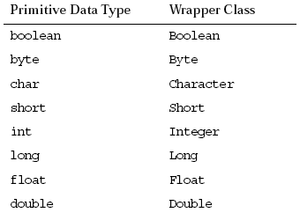
Wrapper Classes
The Java programming language provides wrapper classes to manipulate primitive data elements as objects.
Each Java primitive data type has a corresponding wrapper class in the java.lang package.
The following figure displays the primitive data types with their wrapper classes.

Slide 36
Autoboxing of Primitive Types
The autoboxing feature enables to assign and retrieve primitive types without the need of the wrapper classes.
The compiler will now create the wrapper object automatically when assigning a primitive to a variable of the wrapper class type.
The compiler will extract the primitive value when assigning from a wrapper object to a primitive variable.

Slide 37
Summary
In this session, you learned that:
  Arrays are objects used to group data objects of the same type. Arrays can be of primitive or class type.
  Arrays can be created by using the new keyword.
  A multidimensional array is an array of arrays.
  All array indices begin at 0. The number of elements in an array is stored as part of the array object in the length attribute.
  An array once created can not be resized. However, the same reference variable can be used to refer to an entirely new array.
  The Java programming language permits a class to extend only a single class.

Slide 38
Summary (Contd.)
  Variables and methods can be at one of the four access levels: public, protected, default, or private.
  The existing behavior of a base class can be modified by overriding the methods of the base class.
  A subclass method may invoke a superclass method using the super keyword.
  Polymorphism is the ability to have many different forms.
  Casting objects is used where you have received a reference to a parent class, and you want to access the full functionality of the object of the subclass.
  The methods which perform closely related tasks can be given the same name by overloading them.

Slide 39
Summary (Contd.)
  The varargs feature helps you to write a generic code to pass variable number of arguments, of the same type to a method.
  The super keyword is used to call the constructor of the parent class.
  The Object class is the root of all classes.
  The two important methods of the object class are equals() method and toString() method.
  Wrapper classes are used to manipulate primitive data elements as objects. Each Java primitive data type has a corresponding wrapper class in the java.lang package.
  Autoboxing feature enables you to assign and retrieve primitive types without the need of the wrapper classes.

